Slide 1
CGEMS
Phase I UI Scope

Slide 2
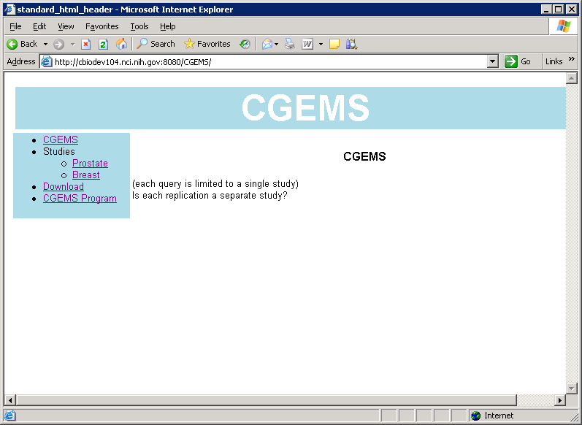
Home page
Navigation bar as suggested by Carl’s wire frames located at http://cbiodev104.nci.nih.gov:8080/CGEMS/
login on menu bar
All queries constrained by study
login

Slide 3
Public users: search options
prostate study:
  Search SNP Annotations
  Search SNP Association Findings
  Search SNP Frequency (Genotype Summary)

Slide 4
Credentialed users: search options
prostate study:
  Search SNP Annotations
  Search SNP Association Findings
  Search SNP Frequency (Genotype Summary)
  Search Study Participants (login required)
  Search Genotype Findings (login required)

Slide 5
SNP Annotations: search criteria
Genomic Location
  Chromosome No :drop down list
  Start Physical Position | End Physical Position (Integer)
HUGO Gene Symbol list
  Comma separated list in text field or uploaded list
  Max 100 symbols
dbSNP Identifier list
  Comma separated list in text field or uploaded list
  Max 1000 identifiers

Slide 6
SNP Annotations: output
dbSNP Id
Chromosome No
Physical Position
Gene Location
  such as coding-exon|noncoding-exon|intron|intergenic
Gene Symbol(s) |null
SNP Assay Id
SNP Panel Name

Slide 7
SNP Association Findings: search criteria
Analysis Name list
  multi-select drop down list
  list includes “All” (but is not default) default ?
p-value or rank : radio button
  P-value (Float): <=
  rank: >= drop down list
SNP Annotation:
  Genomic Location
    Chromosome No :drop down list
    Start Physical Position | End Physical Position (Integer)
  HUGO Gene Symbol list
    Comma separated list in text field or uploaded list
    Max 100 symbols
  dbSNP Identifier list
    Comma separated list in text field or uploaded list
    Max 1000 identifiers

Slide 8
SNP Association Findings: output
dbSNP Id
p-value
rank
Analysis name
Analysis method name
Analysis group name
Count of participants in analysis group

Slide 9
SNP Frequency Findings: search criteria
Population
  multi-select drop down list
  default selection: none
  list includes “All” (but is not default & means bring back data fetched for individual populations)
Hardy Weinberg pValue (Float): <=
Minor Allele Frequency (Float): >=
Completion Rate (Float): >=
SNP Annotation:
  Genomic Location
    Chromosome No :drop down list
    Start Physical Position | End Physical Position (Integer)
  HUGO Gene Symbol list
    Comma separated list in text field or uploaded list
    Max 100 symbols
  dbSNP Identifier list
    Comma separated list in text field or uploaded list
    Max 1000 identifiers

Slide 10
SNP Frequency Findings: output
dbSNP Id
Population name
Count of participants in population
hardyWeinbergPValue
heterozygoteCount
minorAlleleFrequency
missingAlleleCount
missingGenotypeCount
otherAllele
otherAlleleCount
otherHomozygoteCount
referenceAllele
referenceAlleleCount
referenceHomozygoteCount
completionRate

Slide 11
Study Participant: search criteria
population list: multi-select drop down or analysis group list: multi-select drop down
gender list: multi-select drop down
de-identified Study Participant Identifier List
  Comma separated list in text field or uploaded list
age list in 5 year increments: set max & min age range using dropdowns
case control status: control | case | early case | advanced case
  Note case includes both early case and advanced case
disease
family history: yes| no

Slide 12
Study Participant: output
gender
de-identified Study Participant Identifier
age (in 5 year increments)
case control status
disease
family history
population name
analysis group name

Slide 13
Genotype Finding: search criteria
Email address (where query completion notification will be sent)
Status: QCPositive (default) | QCNegative | All
Study Participant
  gender list: multi-select drop down
  de-identified Study Participant Identifier (String)
  age list in 5 year increments: set max & min age range using dropdowns
  case control status: control | case | early case | advanced case
    Note case includes both early case and advanced case
  disease
  family history: yes| no
  Population list: multi-select drop down
  Analysis group list: multi-select drop down
SNP Annotation:
  Genomic Location
    Chromosome No :drop down list
    Start Physical Position | End Physical Position (Integer)
  HUGO Gene Symbol list
    Comma separated list in text field or uploaded list
    Max 100 symbols
  dbSNP Identifier list
    Comma separated list in text field or uploaded list
    Max 1000 identifiers

Slide 14
Genotype Finding: output
dbSNP ID
de-identified Study Participant ID
qualityScore
status
allele1
allele2
normalizedXIntensity
normalizedYIntensity
rawXIntensity
rawYIntensity

